Slide 1
Sequential Logic
Elements of Computing Systems, Nisan & Schocken, MIT Press www.idc.ac.il/tecs
Usage and Copyright Notice:
Copyright 2005 © Noam Nisan and Shimon Schocken
This presentation contains lecture materials that accompany the textbook “The Elements of Computing Systems” by Noam Nisan & Shimon Schocken, MIT Press, 2005.
We provide both PPT and PDF versions.
The book web site, www.idc.ac.il/tecs , features 13 such presentations, one for each book chapter. Each presentation is designed to support about 3 hours of classroom or self-study instruction.
You are welcome to use or edit this presentation as you see fit for instructional and non-commercial purposes.
If you use our materials, we will appreciate it if you will include in them a reference to the book’s web site.
If you have any questions or comments, you can reach us at tecs.ta@gmail.com

Slide 2
Sequential VS combinational logic
Combinational devices: operate on data only;
provide calculation services (e.g. Nand … ALU)
Sequential devices: operate on data and a clock signal;
as such, contain state and can ve made to provide storage and synchronization services
Sequential devices are sometimes called “clocked devices”
The low-level behavior of clocked / sequential gates is tricky
The good news:
  All sequential chips can be based on one low-level sequential gate, called “data flip flop”, or DFF
  The complex clock-dependency details can be encapsulated at the low-level DFF level
  All the higher-level sequential chips can be built on top of the DFF using combinational logic only.

Slide 3
Lecture plan
Clock
A hierarchy of memory chips:
  Flip-flop gates
  Binary cells
  Registers
  RAM
Counters
Perspective.

Slide 4
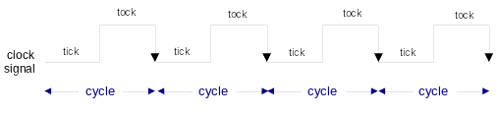
The Clock
HW
simulator
demo
In our jargon, a clock cycle = tick-phase (low), followed by a
tock-phase (high)
In real hardware, the clock is implemented by an oscillator
In our hardware simulator, clock cycles can be simulated either
  Manually, by the user, or
  “Automatically,” by a test script.

Slide 5
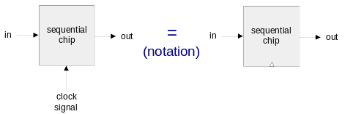
Flip-flop
HW
simulator
demo
in
DFF
out
out(t) = in(t-1)
A fundamental state-keeping device
For now, let us not worry about the DFF implementation
Memory devices are made from numerous flip-flops, all regulated by the same master clock signal
Notational convention:

Slide 6
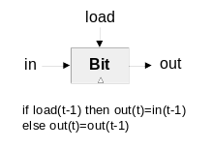
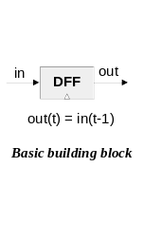
1-bit register (we call it “Bit”)
Objective: build a storage unit that can:
Change its state to a given input
Maintain its state over time (until changed)
in
DFF
out
load
in
out
MUX
DFF
out(t) = out(t-1) ?
out(t) = in(t-1) ?
Won’t work
if load(t-1) then out(t)=in(t-1)
else out(t)=out(t-1)
OK

Slide 7
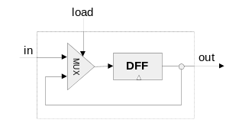
Bit (cont.)
HW
simulator
demo
Interface
Implementation
Load bit
Read logic
Write logic

Slide 8
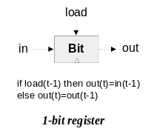
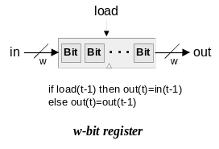
Multi-bit registers
HW
simulator
demo
Register’s width: a trivial parameter
Read logic
Write logic

Slide 9
Aside: Hardware Simulation
HW
simulator
demo
Relevant topics from the HW simulator tutorial:
Clocked chips: When a clocked chip is loaded into the simulator, the clock icon is turned on, and the user can use it to control the clock
Built-in chips:
  feature a standard HDL interface yet a Java implementation
  Provide behavioral simulation services
  May have GUI effects.

Slide 10
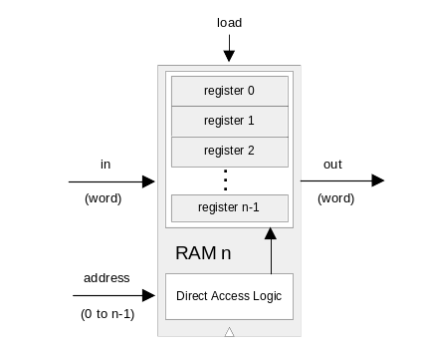
Random Access Memory (RAM)
HW
simulator
demo
Read logic
Write logic.

Slide 11
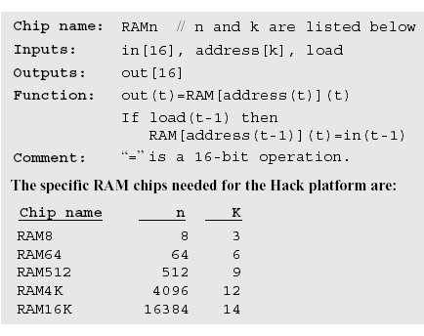
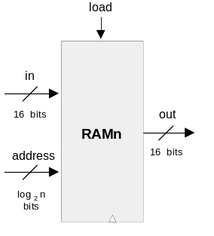
RAM interface

Slide 12
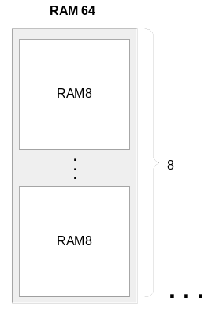
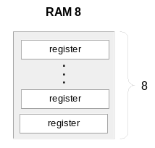
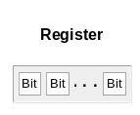
RAM anatomy
Recursive ascent

Slide 13
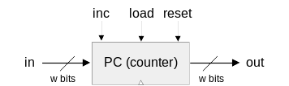
Counter
Needed: a storage device that can:
(a) set its state to some base value
(b) increment the state in every clock cycle
(c) maintain its state (stop incrementing) over clock cycles
(d) reset its state
If reset(t-1) then out(t)=0
else if load(t-1) then out(t)=in(t-1)
else if inc(t-1) then out(t)=out(t-1)+1
else out(t)=out(t-1)
Typical function: program counter
Implementation: register chip + some combinational logic.

Slide 14
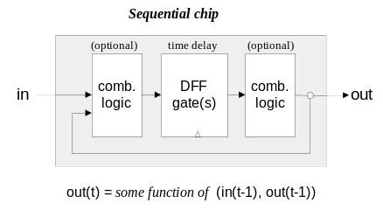
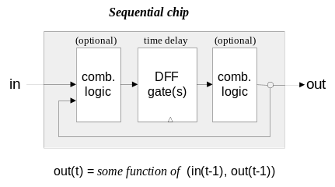
Recap: Sequential VS combinational logic

Slide 15
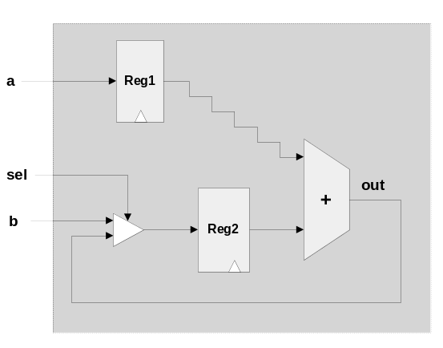
Time matters
During a tick-tock cycle, the internal states of all the clocked chips are allowed to change, but their outputs are “latched”
At the beginning of the next cycle, the outputs of all the clocked chips in the architecture commit to the new values.
Implications:
Challenge: propagation delays
Solution: clock synchronization
Cycle length and processing speed.

Slide 16
Perspective
All the memory units described in this lecture are standard
Typical memory hierarchy
  SRAM (“static”), typically used for the cache
  DRAM (“dynamic”), typically used for main memory
  Disk
  (Elaborate caching / paging algorithms)
A Flip-flop can be built from Nand gates
But ... real memory units are highly optimized, using a great variety of storage technologies.
Access
time
Cost

